Slide 1

Chicago Crime Analysis
Ashish Kumar Sah

Slide 2
Problem Statement
The government initiated an operation to address the high crime rates in Chicago.
Despite this effort, it's crucial to assess the effectiveness of the operation and identify areas for improvement.

Slide 3
Objective
Evaluate if the case-solving time has improved.
Identify the localities with higher crime rates.
Propose measures to further improve crime rates.

Slide 4
Key Matrices
Total Crime Cases : 90 K
Total Arrest Rate : 12 %
Average Time Difference Between Solving Cases : 9.03
Average Crime Per Location : 755.60
Total Domestic Crime : 18 K

Slide 5
Analytical Approach and Tools
Data Cleaning and Preparation
    Tools Used: Power Query Editor in Power BI
    Steps Taken: 1. Imported raw crime data.
2. Addressed inconsistencies and missing values.
3. Standardized date and time formats.
Data Enrichment
    Enhanced dataset with calculated columns and measures.
Visualization and Reporting
    Created charts and graphs in Power BI.
    Implemented slicers for interactive filtering.

Slide 6
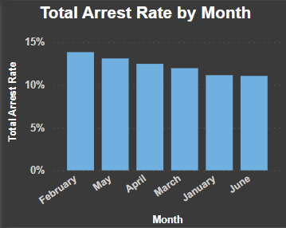
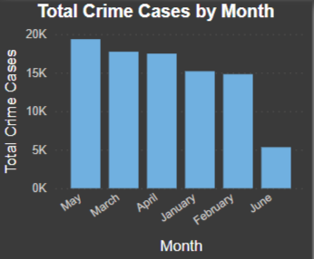
Case Solving Time Analysis
Findings:
    The average time between reporting and solving a case is 9 days.
Analysis:
    Crime rate dropped 75% from May to June
    The arrest rate has been low for each month ranging between 11% and 14%.
    This metric provides a benchmark to evaluate future improvements.
    Regular monitoring and comparison with future data will help assess progress.

Slide 7
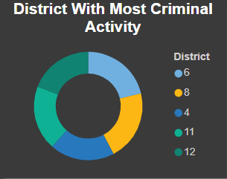
High Crime Localities
Findings:
    Top 5 districts with the highest number of crimes: District 6, District 8, District 4, District 11, and District 12.
Analysis:
    These districts show significantly higher criminal activity.
    Focused law enforcement and community initiatives can help reduce crime rates.
Conclusion:
    Prioritizing resources and implementing targeted strategies in these districts is crucial for crime reduction.

Slide 8
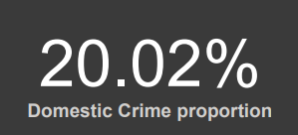
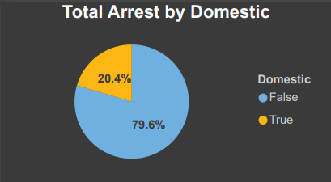
Domestic Crime Proportion Analysis
Findings:
  Percentage of Domestic Crimes: 20.2% of total crimes
  Arrest Rate for Domestic Crimes: 20.4%
Analysis:
  Domestic crimes account for a significant portion of all reported crimes.
  The arrest rate for domestic crimes is higher than the overall arrest rate, suggesting effective policing in this area.
Conclusion:
  Strengthening community programs and support services is essential to reduce domestic crimes further.

Slide 9
Strategies for Crime Reduction
Findings:
    Focus on the top 5 crime types: Theft, Battery, Criminal Damage, Assault, Other Offense.
Analysis:
    Enhancing surveillance and patrolling in high-crime areas.
    Community engagement and awareness programs.
    Strengthening law enforcement presence in vulnerable areas.
Conclusion:
    Targeted measures focusing on prevalent crime types and high-crime areas can significantly reduce overall crime rates.

Slide 10
REPORTS

Slide 11
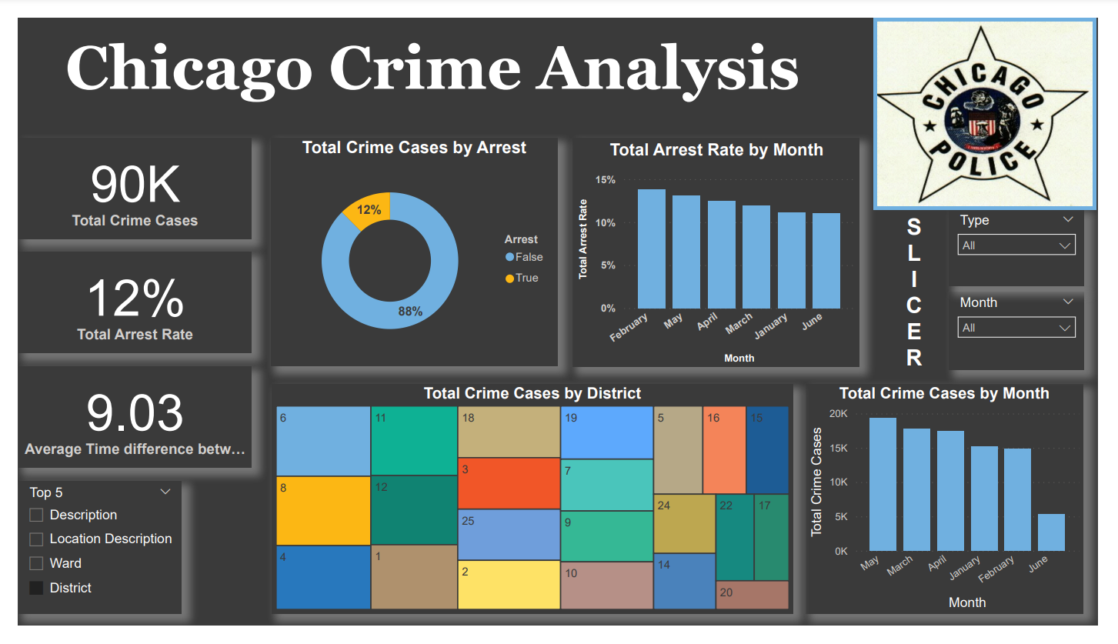

Slide 12
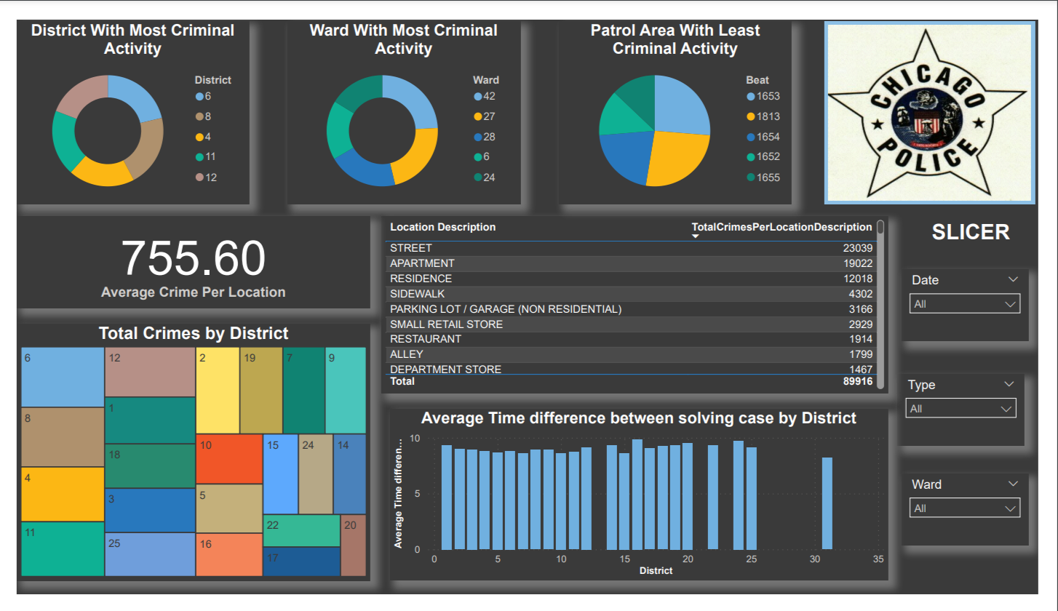

Slide 13
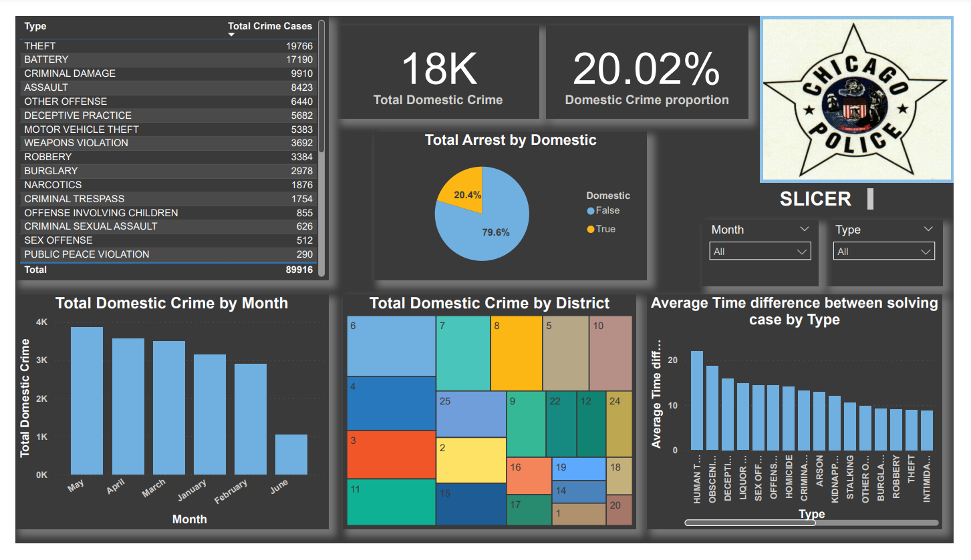

Slide 14
THANK YOU

